Slide 1
The Economics of Brain Size Evolution in Vertebrates
Balancing energy costs and cognitive benefits in animals
Notes:
---

Slide 2
Introduction
Notes:
---
This slide references information from the following file: https://units-my.sharepoint.com/personal/12048_ds_units_it/Documents/File%20chat%20di%20Microsoft%20Copilot/The%20economics%20of%20brain%20size%20evolution%20in%20vertebrates%20Heldstab%202022.pdf
Overview of brain size variation and evolutionary context

Slide 3

Overview of brain size variation and evolutionary context
Brain Size and Cognition
  Larger brain sizes across vertebrates often link to enhanced cognitive abilities and complex behaviors.
Energetic Costs of Large Brains
  The evolution of larger brains involves significant energetic costs that species must balance for survival.
Energy Trade-offs and Adaptations
  Species optimize energy allocation via ecological and social adaptations to support brain enlargement.
Notes:
---
This slide references information from the following file: https://units-my.sharepoint.com/personal/12048_ds_units_it/Documents/File%20chat%20di%20Microsoft%20Copilot/The%20economics%20of%20brain%20size%20evolution%20in%20vertebrates%20Heldstab%202022.pdf
Brain size varies significantly across vertebrate species, with larger brains generally associated with enhanced cognitive abilities. However, the evolution of larger brains presents a paradox due to their high energetic costs. This presentation explores the economic trade-offs involved in brain size evolution, emphasizing how species manage the energy demands of larger brains. The review by Heldstab et al. (2022) highlights that understanding brain size evolution requires not only examining cognitive benefits but also the energetic constraints and compensatory strategies that enable such evolution. The authors argue that brain enlargement is feasible only when cognitive advantages translate into improved energy balance or when energy allocation is optimized through ecological or social adaptations.

Slide 4
Evolutionary Hypotheses
Notes:
---
This slide references information from the following file: https://units-my.sharepoint.com/personal/12048_ds_units_it/Documents/File%20chat%20di%20Microsoft%20Copilot/The%20economics%20of%20brain%20size%20evolution%20in%20vertebrates%20Heldstab%202022.pdf
Key hypotheses explaining brain size evolution

Slide 5

Key hypotheses explaining brain size evolution
Expensive Brain Hypothesis
  Brain enlargement requires increased energy intake or reduced energy allocation to other costly functions.
Expensive Tissue Hypothesis
  Larger brains evolved at the expense of other metabolically costly organs like the digestive tract.
Maternal Energy Hypothesis
  Maternal energy investment during development limits offspring brain size expansion.
Ecological and Social Brain Hypotheses
  Cognitive demands from environment and social complexity drive brain size increase.
Notes:
---
This slide references information from the following file: https://units-my.sharepoint.com/personal/12048_ds_units_it/Documents/File%20chat%20di%20Microsoft%20Copilot/The%20economics%20of%20brain%20size%20evolution%20in%20vertebrates%20Heldstab%202022.pdf
Several hypotheses have been proposed to explain the evolution of large brains in vertebrates. The Expensive Brain Hypothesis posits that brain enlargement must be offset by increased energy intake or reduced allocation to other costly functions. The Expensive Tissue Hypothesis suggests that larger brains evolved at the expense of other organs, such as the digestive tract. The Maternal Energy Hypothesis emphasizes the role of maternal energy investment during development in constraining offspring brain size. Additionally, the Ecological Brain Hypothesis and Social Brain Hypothesis propose that cognitive demands from environmental challenges or social complexity drive brain expansion. These hypotheses collectively underscore the importance of energetic trade-offs and ecological context in shaping brain size evolution.

Slide 6
Energetic Costs of Brains
Notes:
---
This slide references information from the following file: https://units-my.sharepoint.com/personal/12048_ds_units_it/Documents/File%20chat%20di%20Microsoft%20Copilot/The%20economics%20of%20brain%20size%20evolution%20in%20vertebrates%20Heldstab%202022.pdf
Metabolic demands and developmental constraints

Slide 7

Metabolic demands and developmental constraints
Brain Energy Consumption
  The human brain uses 20–25% of daily energy despite being only 2% of body weight.
Energy Demand During Development
  Immature brains allocate over 50% of energy intake to growth, increasing metabolic needs.
Developmental Trade-offs
  Brain growth competes with body and reproductive growth, delaying overall development.
Adaptations for Energy Balance
  Ecological and social adaptations help offset energy costs for brain enlargement.
Notes:
---
This slide references information from the following file: https://units-my.sharepoint.com/personal/12048_ds_units_it/Documents/File%20chat%20di%20Microsoft%20Copilot/The%20economics%20of%20brain%20size%20evolution%20in%20vertebrates%20Heldstab%202022.pdf
Brains are among the most energetically expensive tissues in the body. In humans, the brain consumes approximately 20–25% of daily energy expenditure while comprising only 2% of body weight. During development, energy demands are even higher, with immatures sometimes allocating over 50% of their energy intake to brain growth. These high costs necessitate prioritization of brain energy needs over other organs and functions. The energy-intensive nature of synaptic transmission further exacerbates these demands. Consequently, brain development competes with somatic and reproductive growth, leading to slower overall development and delayed reproduction. These constraints limit the feasibility of brain enlargement unless offset by ecological or social adaptations that improve energy availability or reduce competing demands.

Slide 8
Compensatory Strategies
Notes:
---
This slide references information from the following file: https://units-my.sharepoint.com/personal/12048_ds_units_it/Documents/File%20chat%20di%20Microsoft%20Copilot/The%20economics%20of%20brain%20size%20evolution%20in%20vertebrates%20Heldstab%202022.pdf
Mechanisms to offset brain energy costs

Slide 9
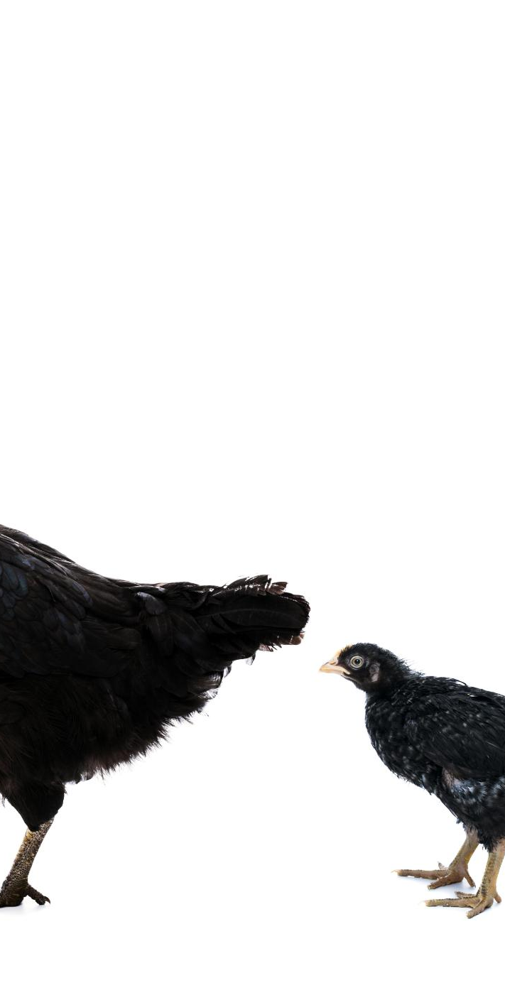
Mechanisms to offset brain energy costs
Increased Energy Intake
  Species boost brain energy by consuming high-quality diets rich in fruits, insects, or meat.
Energy Allocation Reduction
  Reducing energy use in other functions like smaller digestive tracts helps balance brain energy demands.
Allomaternal Care Support
  Non-breeding group members assist in offspring care, reducing reproductive energy costs for the mother.
Delayed Growth and Reproduction
  Slower development and delayed reproduction provide more time for brain maturation and growth.
Notes:
---
This slide references information from the following file: https://units-my.sharepoint.com/personal/12048_ds_units_it/Documents/File%20chat%20di%20Microsoft%20Copilot/The%20economics%20of%20brain%20size%20evolution%20in%20vertebrates%20Heldstab%202022.pdf
Species employ various strategies to compensate for the high energy costs of larger brains. One approach is increasing energy intake through high-quality diets rich in fruits, insects, or meat. Another strategy involves reducing energy allocation to other functions, such as shrinking the digestive tract or minimizing fat storage. Allomaternal care, where non-breeding group members assist in offspring rearing, alleviates reproductive energy burdens and supports brain development. Additionally, slower growth and delayed reproduction allow more time for brain maturation. These compensatory mechanisms enable species to evolve larger brains without compromising survival or reproductive success. However, their effectiveness varies across lineages, depending on ecological conditions and social structures.

Slide 10
Cognitive Benefits
Notes:
---
This slide references information from the following file: https://units-my.sharepoint.com/personal/12048_ds_units_it/Documents/File%20chat%20di%20Microsoft%20Copilot/The%20economics%20of%20brain%20size%20evolution%20in%20vertebrates%20Heldstab%202022.pdf
Enhanced cognition and adaptive advantages

Slide 11
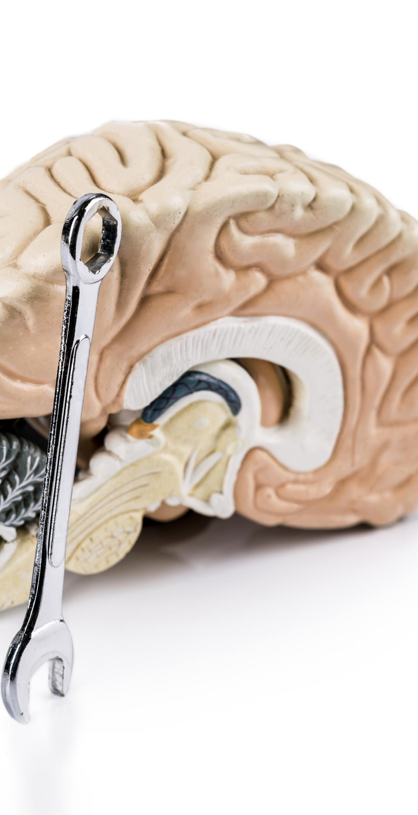
Enhanced cognition and adaptive advantages
Cognitive Benefits of Larger Brains
  Larger brains improve spatial memory, problem-solving, and behavioral flexibility, boosting survival and reproduction.
Adaptive Foraging and Tool Use
  Species with larger brains develop complex foraging strategies and use tools to thrive in novel environments.
Social Learning and Innovation
  Enhanced cognition enables social learning, innovation, and effective knowledge transmission among individuals.
Energy Balance and Evolution
  Brain enlargement is viable when cognitive benefits improve energy balance or compensatory strategies reduce costs.
Notes:
---
This slide references information from the following file: https://units-my.sharepoint.com/personal/12048_ds_units_it/Documents/File%20chat%20di%20Microsoft%20Copilot/The%20economics%20of%20brain%20size%20evolution%20in%20vertebrates%20Heldstab%202022.pdf
Larger brains confer significant cognitive benefits that enhance survival and reproduction. These include improved spatial memory, problem-solving abilities, and behavioral flexibility. Species with larger brains are better equipped to develop complex foraging strategies, use tools, and adapt to novel environments. Enhanced cognition also facilitates social learning and innovation, allowing individuals to acquire and transmit knowledge more effectively. These advantages can lead to increased access to resources, reduced mortality, and greater reproductive success. However, for brain enlargement to be evolutionarily viable, these cognitive benefits must translate into improved energy balance or be supported by compensatory strategies that mitigate the associated costs.

Slide 12
Ecological and Social Advantages
Notes:
---
This slide references information from the following file: https://units-my.sharepoint.com/personal/12048_ds_units_it/Documents/File%20chat%20di%20Microsoft%20Copilot/The%20economics%20of%20brain%20size%20evolution%20in%20vertebrates%20Heldstab%202022.pdf
Environmental and social drivers of brain expansion

Slide 13

Environmental and social drivers of brain expansion
Ecological Influences on Brain Size
  Brain size correlates with habitat complexity and diet quality, promoting behavioral flexibility and resource exploitation.
Social Factors in Brain Evolution
  Social dynamics like group size and cooperation drive cognitive demands, supporting the Social Brain Hypothesis.
Energy and Reproductive Costs
  Social benefits must enhance energy acquisition or reduce reproductive costs to enable brain expansion.
Interplay of Ecological and Social Factors
  Brain size evolution results from the combined influence of ecological complexity and social advantages.
Notes:
---
This slide references information from the following file: https://units-my.sharepoint.com/personal/12048_ds_units_it/Documents/File%20chat%20di%20Microsoft%20Copilot/The%20economics%20of%20brain%20size%20evolution%20in%20vertebrates%20Heldstab%202022.pdf
Ecological factors such as habitat complexity, diet quality, and colonization success are strongly associated with brain size. Larger-brained species often inhabit more complex environments and exhibit greater behavioral flexibility, enabling them to exploit diverse resources and adapt to changing conditions. Social factors, including group size, pair-bonding, and cooperative behaviors, also influence brain evolution. The Social Brain Hypothesis suggests that managing social relationships and anticipating others' actions requires advanced cognition. However, social benefits must contribute to energy acquisition or reduce reproductive costs to support brain enlargement. The interplay between ecological and social advantages highlights the multifaceted nature of brain size evolution.

Slide 14
Conclusions and Future Directions
Notes:
---
This slide references information from the following file: https://units-my.sharepoint.com/personal/12048_ds_units_it/Documents/File%20chat%20di%20Microsoft%20Copilot/The%20economics%20of%20brain%20size%20evolution%20in%20vertebrates%20Heldstab%202022.pdf
Summary and research outlook

Slide 15
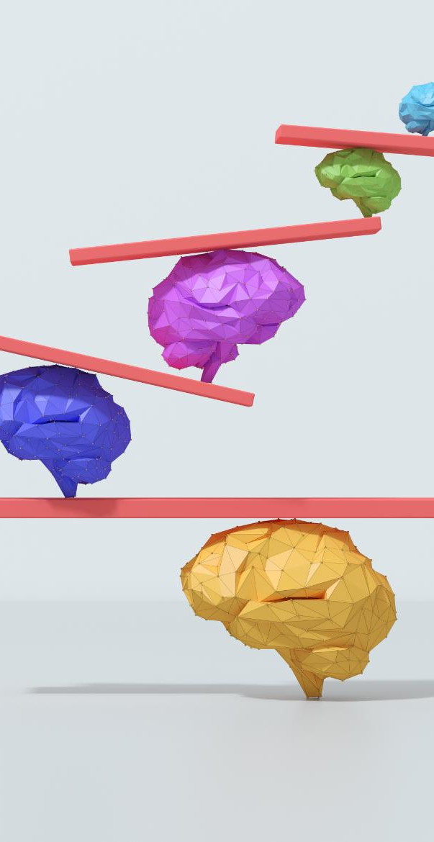
Summary and research outlook
Energetic Costs and Benefits
  Brain size evolution balances high energy demands with cognitive advantages, requiring stable energy input or reallocation.
Broad Research Scope
  Future studies should include ectothermic vertebrates and invertebrates to better understand brain evolution across species.
Functional Brain Regions and Development
  Investigate specific brain regions and skill acquisition timing to clarify cognitive adaptations and evolution mechanisms.
Integrated Ecological Perspectives
  A comprehensive approach combining ecological, social, and energetic factors is vital for advancing brain evolution research.
Notes:
---
This slide references information from the following file: https://units-my.sharepoint.com/personal/12048_ds_units_it/Documents/File%20chat%20di%20Microsoft%20Copilot/The%20economics%20of%20brain%20size%20evolution%20in%20vertebrates%20Heldstab%202022.pdf
The evolution of brain size in vertebrates is governed by a complex balance of energetic costs and cognitive benefits. The Expensive Brain Hypothesis provides a robust framework for understanding these dynamics, emphasizing the need for stable energy input or reallocation to support brain growth. Future research should expand beyond mammals and birds to include ectothermic vertebrates and invertebrates, exploring how environmental factors and developmental constraints influence brain evolution. Investigating specific brain regions and their functional roles, as well as the timing of skill acquisition during development, will further elucidate the mechanisms underlying cognitive adaptations. A comprehensive approach integrating ecological, social, and energetic perspectives is essential for advancing our understanding of brain size evolution.

