Slide 1
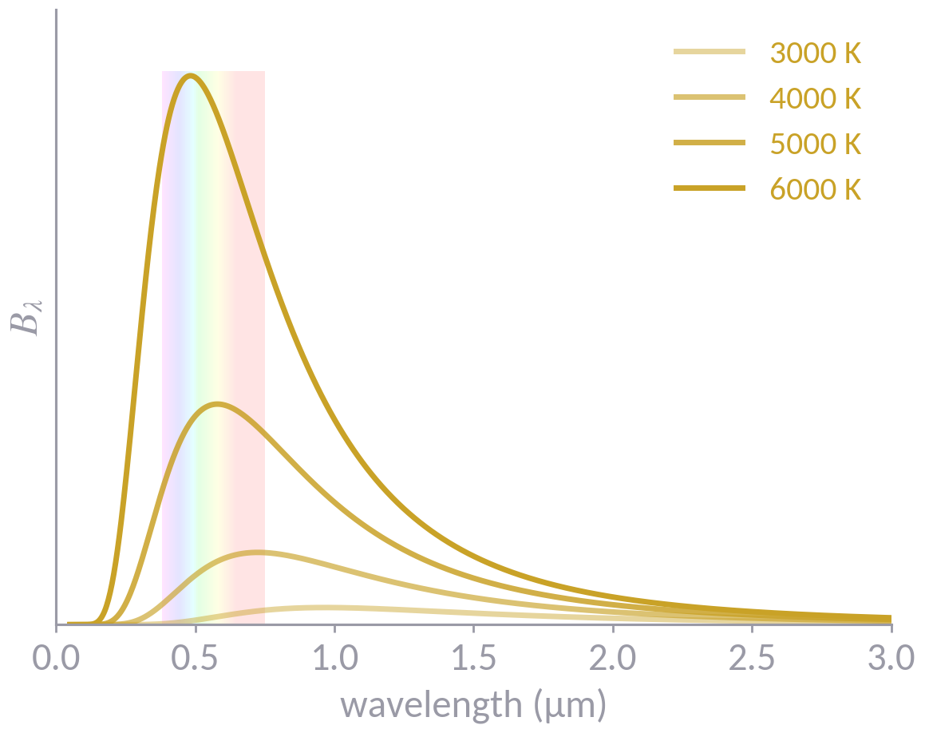
Three roads to the quantum
Wien, Planck and Einstein, from the entropy of radiation to the A and B coefficients
Modern Physics · Lecture 1, part II
Continues from the ultraviolet catastrophe
Notes:
0:00. Two hours. Plan: 0–10 recap; 10–35 Einstein 1905 (entropy of Wien radiation); 35–55 Planck 1900; break; 60–95 Einstein 1917; 95–110 COBE/FIRAS; 110–120 summary and questions.

Slide 2
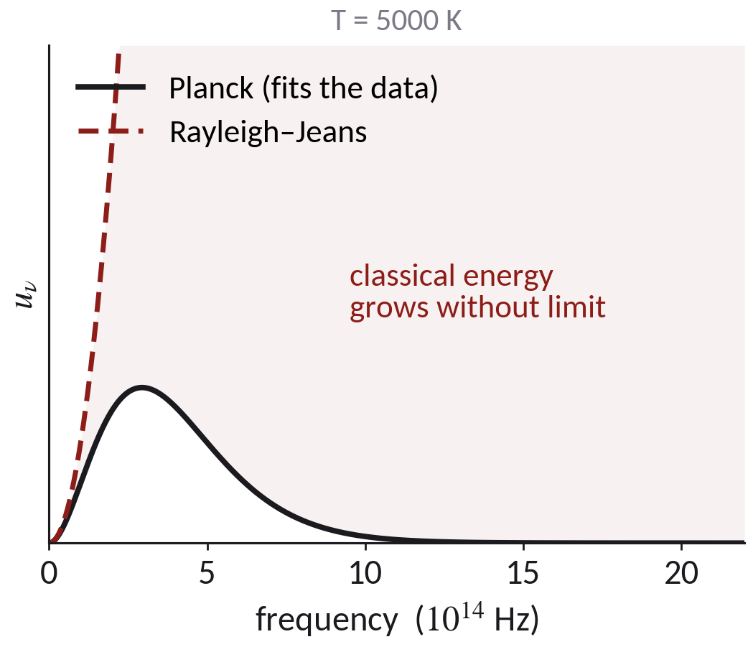
Where we stopped
Mode counting and equipartition give Rayleigh–Jeans, u_{ν} = 8πν²k_{B}T/c³. It follows the data for hν ≪ k_{B}T and its integral diverges.
At high frequency the data follow Wien's form, u_{ν} = aν³ e^{−bν/T}. We treat a and b as fit parameters, not as known constants.
Question before we look at anything else: if u_{ν} is known in only one regime, what does it tell us about the radiation in that regime?
Modern Physics · Lecture 1, part II · Wien, Planck, Einstein
2
Notes:
0–10 min. Let the class answer the question. The point of the next half hour: an empirical formula can contain more physics than its author saw.

Slide 3
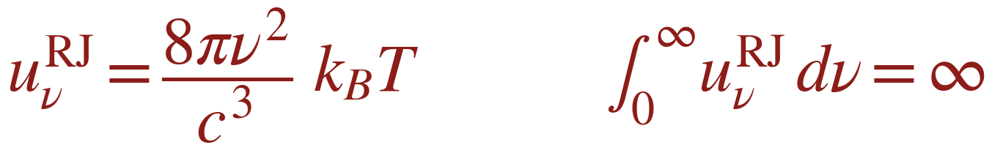
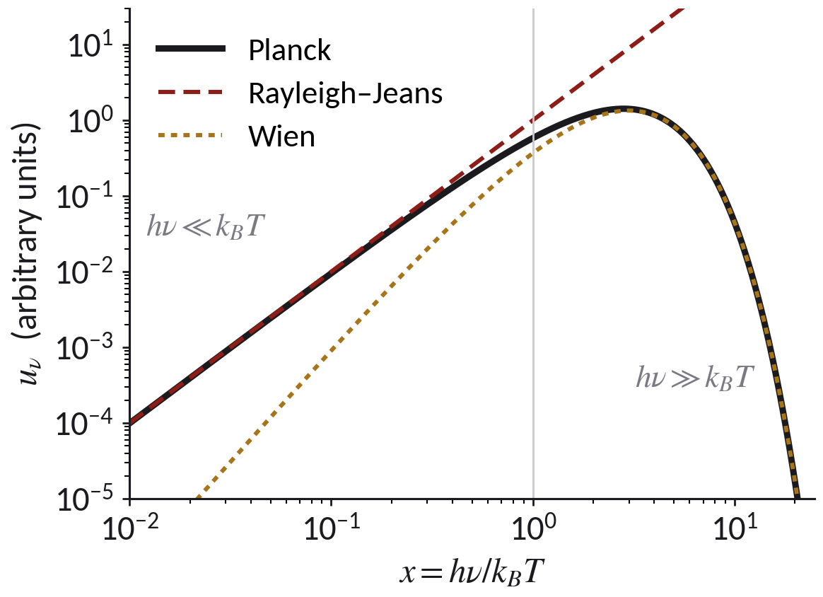
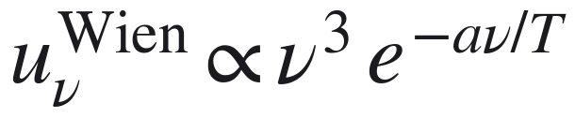
Two half-right laws, three ways forward
right for hν ≪ k_{B}T
right for hν ≫ k_{B}T
Einstein 1905: use only Wien's law and ask what its entropy says.
Planck 1900: interpolate between the two limits, then justify the result.
Einstein 1917: ask which atomic processes can keep matter and radiation in equilibrium.
Modern Physics · Lecture 1, part II · Wien, Planck, Einstein
3
Notes:
All three roads end at the same constant h. The order here is logical, not historical: 1905, then 1900, then 1917.

Slide 4
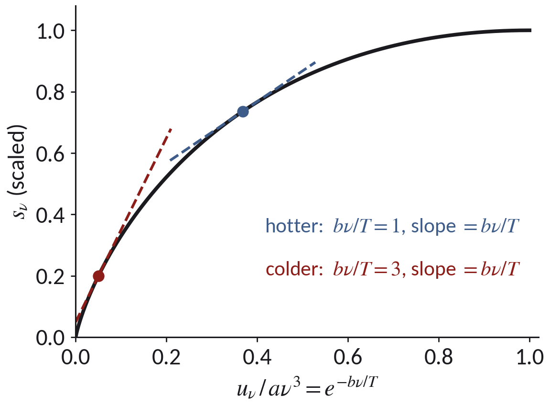
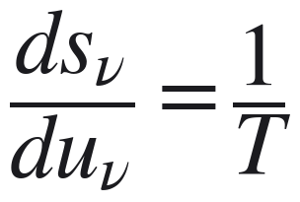
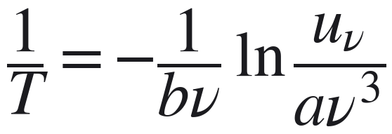
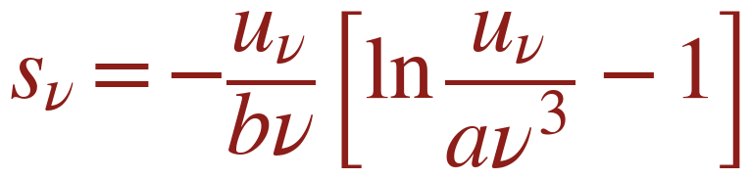
Einstein 1905: the entropy of Wien radiation
Monochromatic radiation in a cavity of volume V. At fixed volume the second law gives, per unit volume and frequency:
Invert Wien's law for 1/T:
Integrate in u_{ν}, with s_{ν}(0) = 0:
The slope of s_ν(u_ν) is 1/T: the colder the radiation, the steeper the curve at small u_ν.
Check: differentiate, and 1/T comes back with no leftover term.
Modern Physics · Lecture 1, part II · Wien, Planck, Einstein
4
Notes:
10–35 min block, slide 1 of 3. Board: write s(u), differentiate, show the bracket [ln(u/aν³) − 1] kills the extra term. Here b = h/k_B and a = 8πh/c³ in modern notation, but Einstein used only Wien's constants.

Slide 5
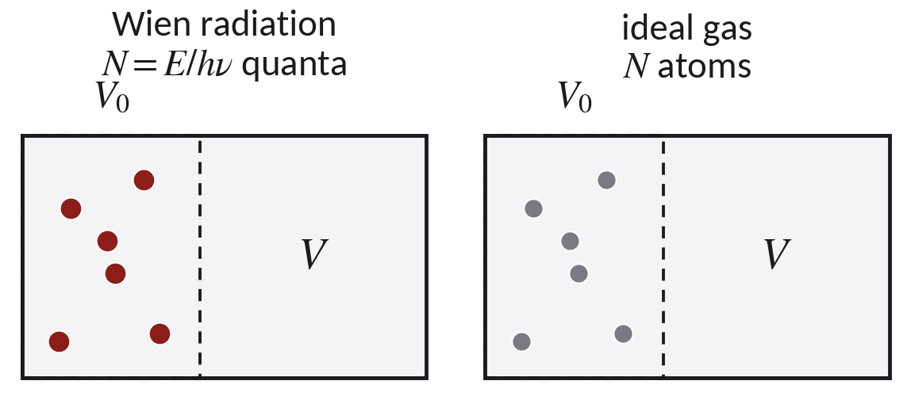
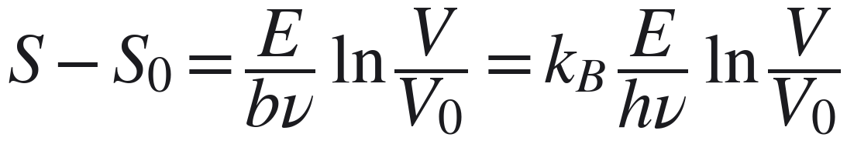
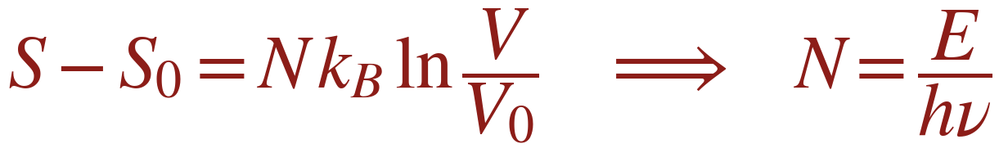
Change the volume at fixed energy
Total entropy S = V dν s_{ν}(E/V dν). Keep E, ν and dν fixed and move from V₀ to V:
Compare an ideal gas of N independent particles:
Boltzmann (S = k_{B} ln W): the probability that all the energy sits in a sub-volume V₀ is (V₀/V)^{E/hν}.
Wien radiation behaves, as far as volume goes, like E/hν independent quanta.
Modern Physics · Lecture 1, part II · Wien, Planck, Einstein
5
Notes:
The identification N = E/hν is the whole result. Say clearly: Einstein did not 'discover the photon'; he showed that Wien radiation has the entropy of a gas of independent quanta.

Slide 6
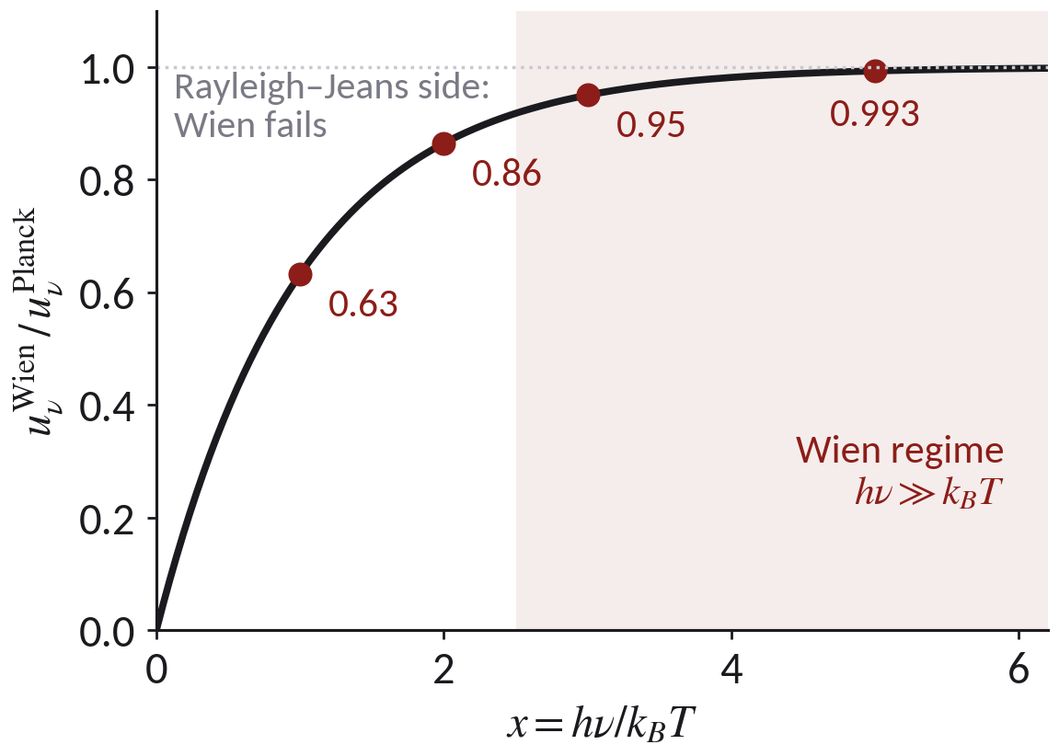
What the entropy argument shows, and what it does not
It shows that, where Wien's law holds, the volume dependence of the entropy is that of N = E/hν independent particles.
It is a thermodynamic result. It is not a derivation of Planck's law.
It holds only for hν ≫ k_{B}T. The ratio of Wien to Planck is 0.63 at x = 1, 0.86 at x = 2, 0.95 at x = 3, 0.993 at x = 5.
At low frequency the energy fluctuations also have a wave term (Einstein 1909). Light quanta remain a hypothesis, to be tested directly.
Bridge to Lecture 2: if a quantum carries hν, an electron that absorbs one receives hν. The photoelectric effect is the test.
Modern Physics · Lecture 1, part II · Wien, Planck, Einstein
6
Notes:
End of the 10–35 min block. Ask: which quantity changes if we move from Wien to Planck: the entropy, the dependence on volume, or both?

Slide 7
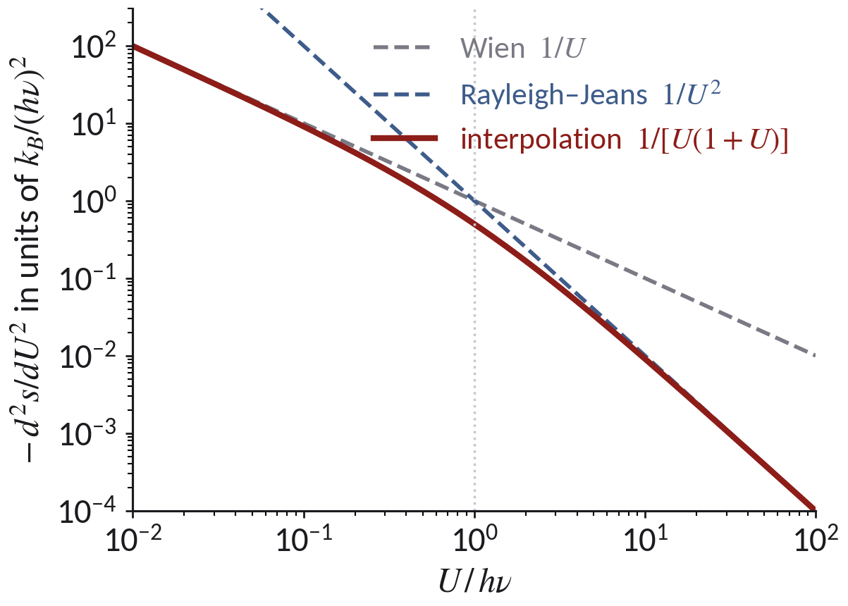
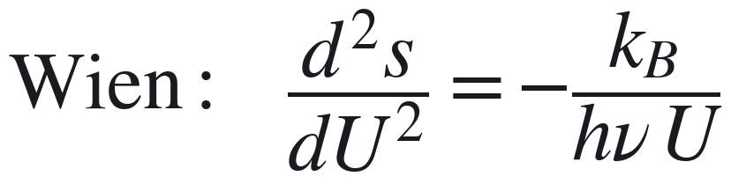
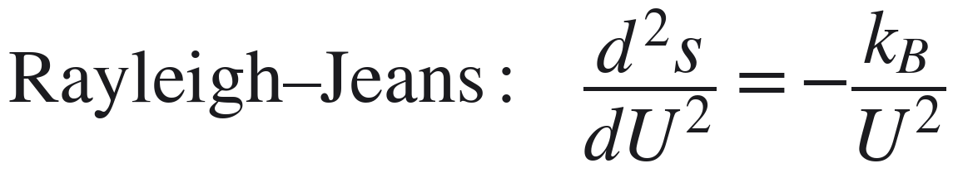
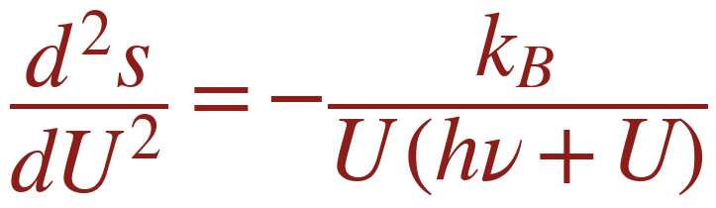
Planck 1900: interpolate the entropy
Entropy s(U) of a resonator of mean energy U, with 1/T = ds/dU. The two measured limits give the curvature:
The simplest form that contains both:
For U ≪ hν it reduces to Wien, for U ≫ hν to Rayleigh–Jeans.
Modern Physics · Lecture 1, part II · Wien, Planck, Einstein
7
Notes:
35–55 min block. The empirical push was Rubens and Kurlbaum (October 1900): u_ν ∝ T in the far infrared where Wien predicts an exponential.

Slide 8
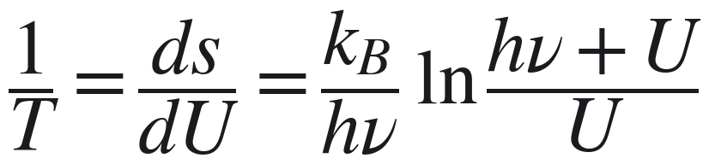
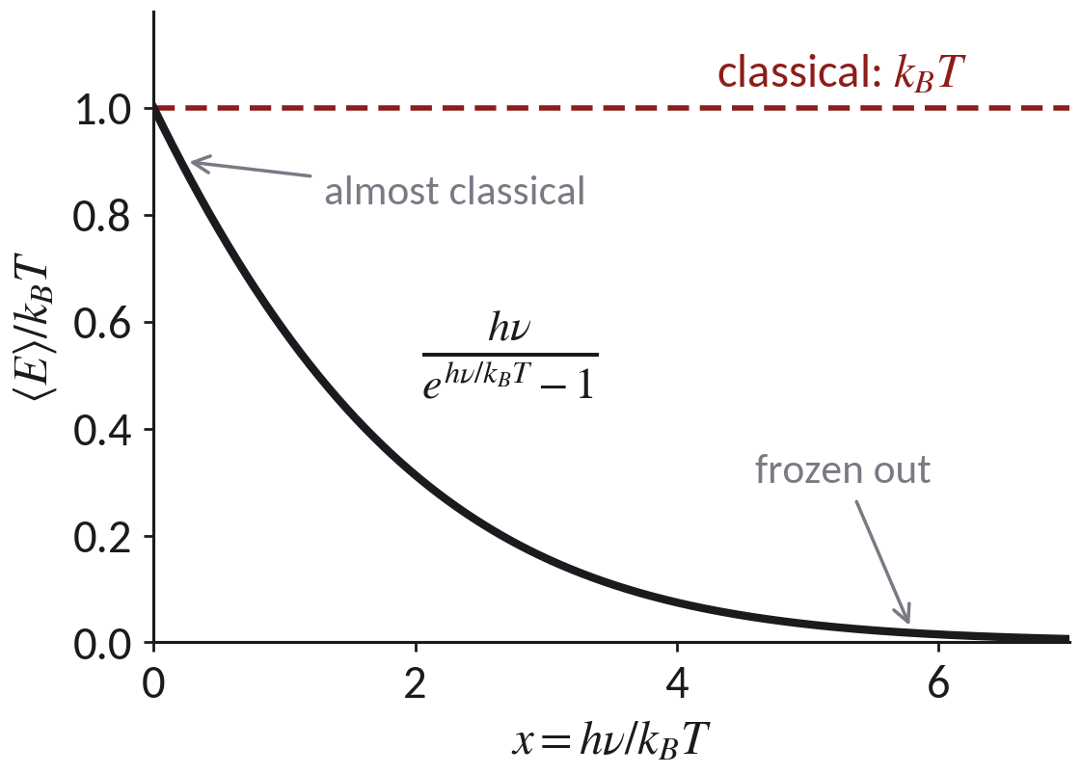
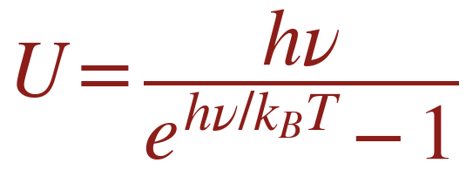
One integration gives the mean energy
Solve for U:
Multiply by the classical mode density g(ν) = 8πν²/c³ and you have Planck's law.
For hν ≪ k_{B}T, ⟨E⟩ → k_{B}T. For hν ≫ k_{B}T, ⟨E⟩ → hν e^{−hν/kBT}.
The interpolation fixes the form of U but does not say why U should have it.
Modern Physics · Lecture 1, part II · Wien, Planck, Einstein
8
Notes:
The explanation comes from counting configurations with energies that are multiples of hν: the next slide.

Slide 9
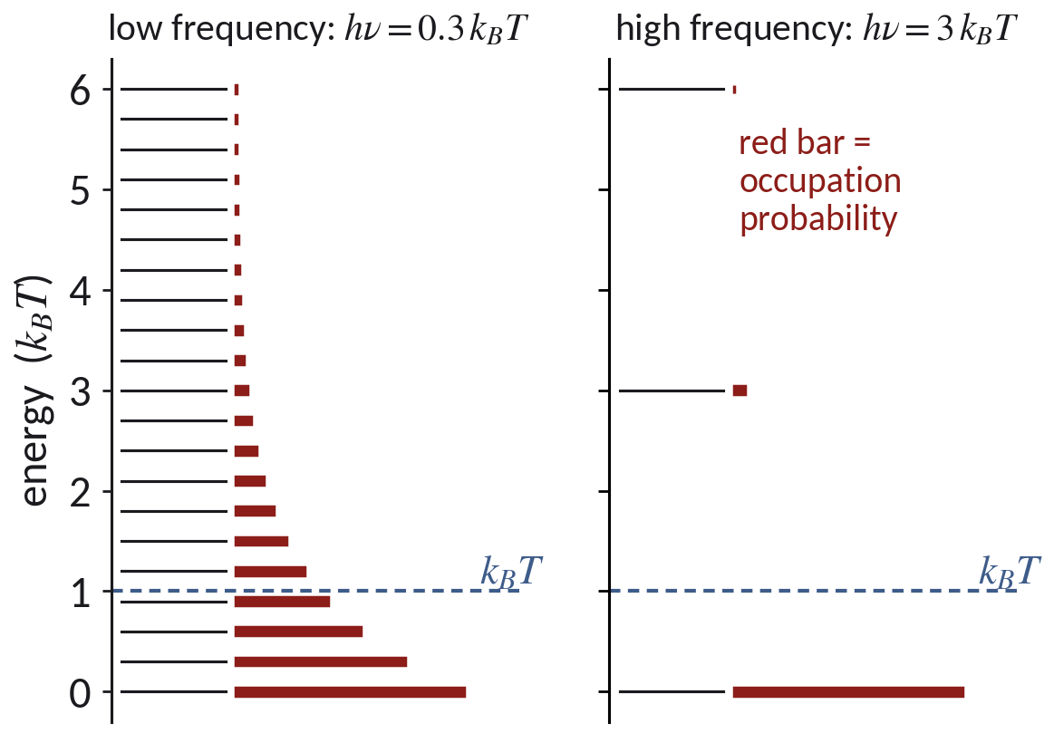
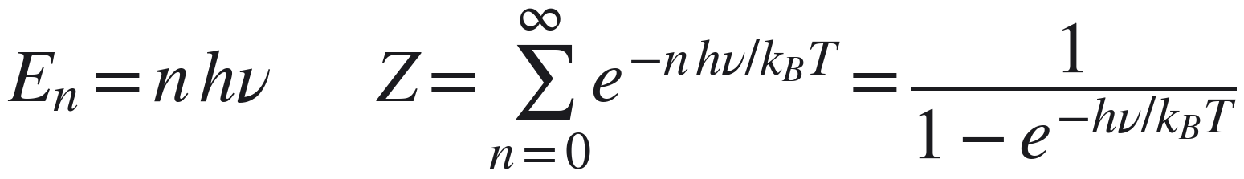
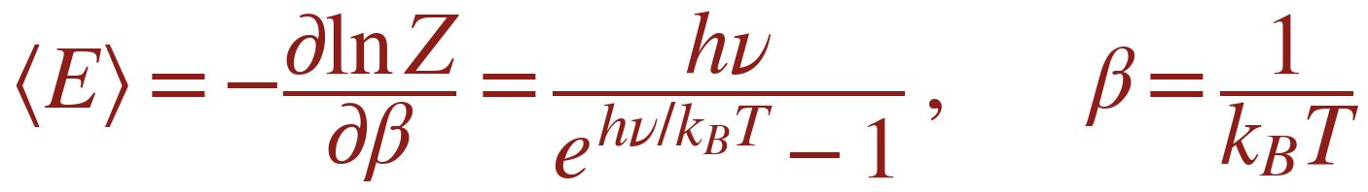
Planck's justification: energy in multiples of hν
Assume the energies of an oscillator are E_{n} = nhν. The Boltzmann sum becomes a geometric series:
Same U as the interpolation, now with a reason.
When hν ≪ k_{B}T many levels are occupied. When hν ≫ k_{B}T almost only n = 0: the mode is frozen out.
Modern Physics · Lecture 1, part II · Wien, Planck, Einstein
9
Notes:
Geometric series and derivative of ln Z on the board. The interpolation was a conjecture; E_n = nhν justifies it at the price of one more hypothesis.

Slide 10
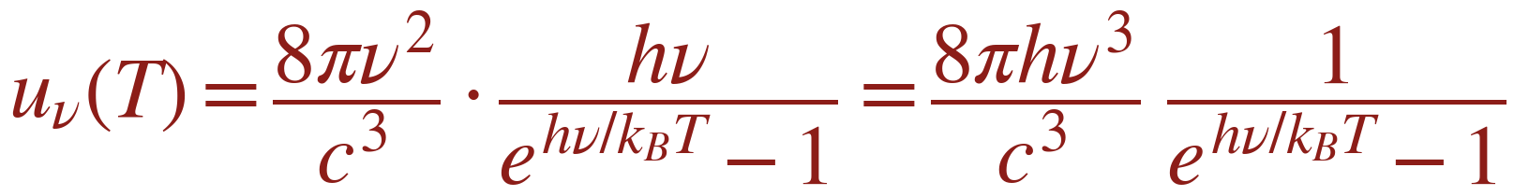
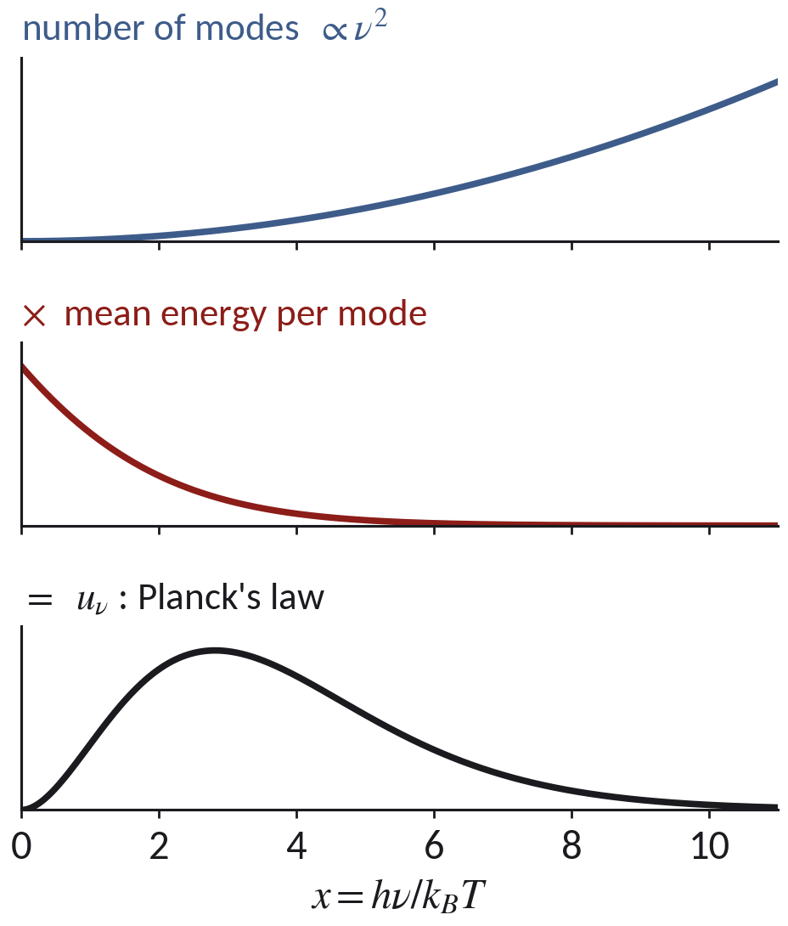
Planck's law: modes × energy per mode
The count of modes, 8πν²/c³, is classical electromagnetism and survives unchanged.
What changes is the energy per mode: k_{B}T becomes hν/(e^{hν/kBT} − 1).
The high-frequency modes are switched off, and the catastrophe disappears.
From the data Planck obtained h = 6.55 × 10⁻³⁴ J s (1901). Since 2019 the SI fixes h = 6.62607015 × 10⁻³⁴ J s.
Modern Physics · Lecture 1, part II · Wien, Planck, Einstein
10
Notes:
Classical geometry times quantum statistics. Planck's k_B was 1.346e-23 J/K.

Slide 11
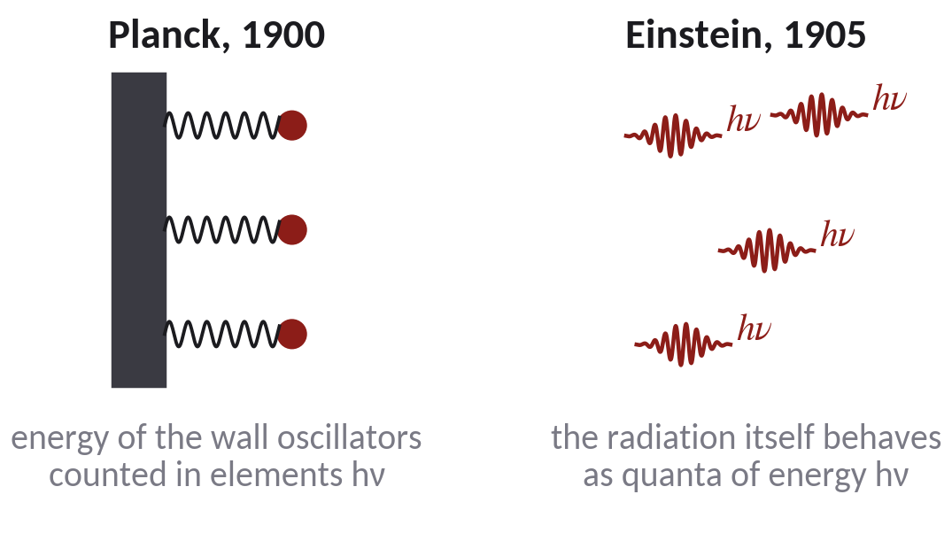
What exactly was quantized?
Planck, 1900: the energy exchanged by the material oscillators in the walls, as a formal counting device.
Einstein, 1905: the radiation itself, at least in the Wien regime: independent quanta of energy hν.
Debye, 1910: each mode of the field, directly. This is the derivation we just did.
One formula, three physical pictures. The blackbody spectrum alone cannot choose among them.
Modern Physics · Lecture 1, part II · Wien, Planck, Einstein
11
Notes:
End of the 35–55 min block. Break (5 min) after this slide. Keep it honest: the spectrum does not force field quantization. Antibunching later in the course does.

Slide 12
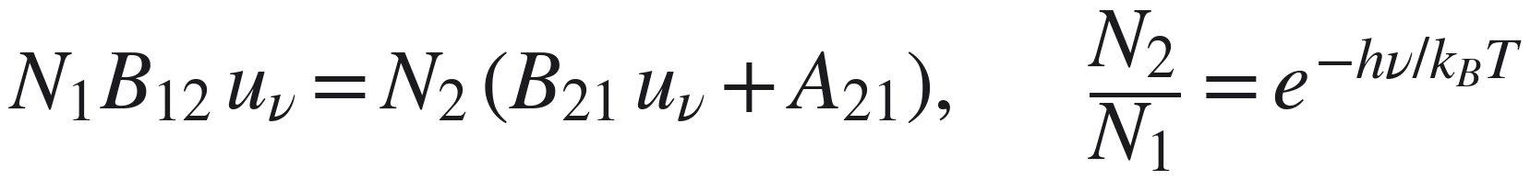
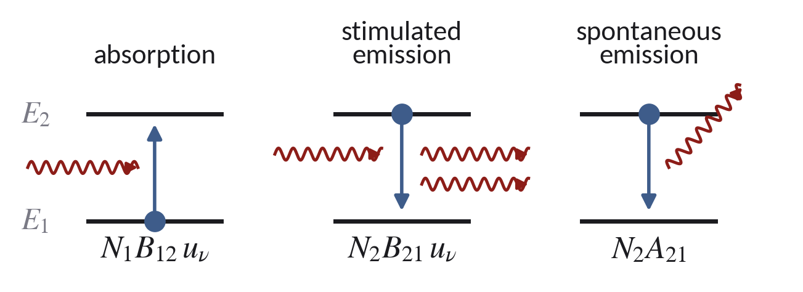
Einstein 1917: three elementary processes
Two atomic levels E₁ < E₂ with E₂ − E₁ = hν, in a radiation field of spectral density u_{ν}.
Absorption and stimulated emission are driven by the field. Spontaneous emission is not.
In equilibrium the upward and downward rates balance, and the populations are Boltzmann:
Modern Physics · Lecture 1, part II · Wien, Planck, Einstein
12
Notes:
60–95 min block. Einstein, 'Zur Quantentheorie der Strahlung', 1917.

Slide 13
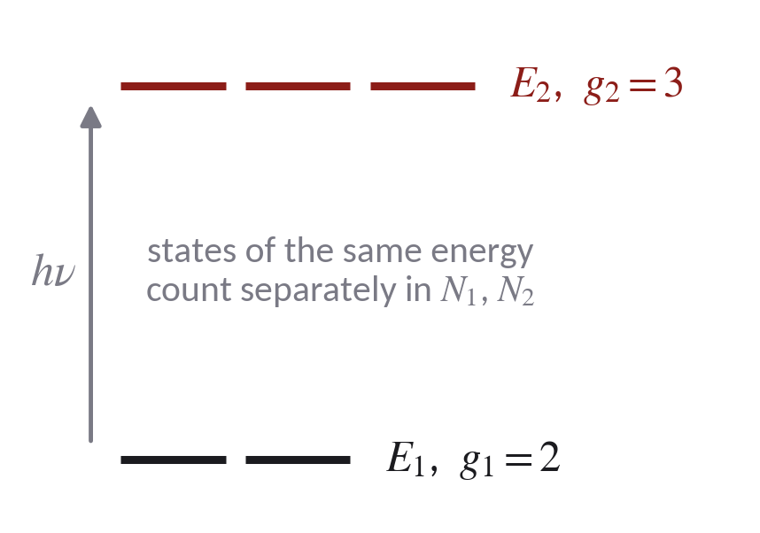
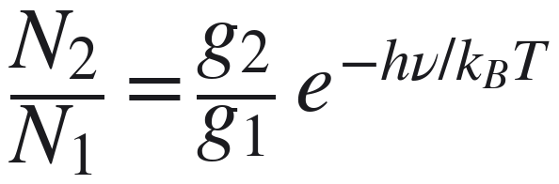
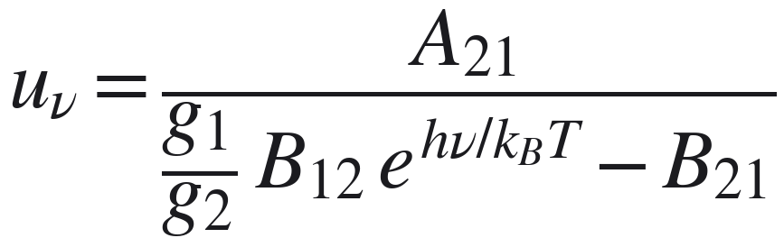
The balance with degenerate levels
Levels E₁ and E₂ with degeneracies g₁ and g₂. States of equal energy are counted separately:
Solving N₁B₁₂u_{ν} = N₂(A₂₁ + B₂₁u_{ν}) for the field:
For a non-degenerate pair set g₁ = g₂ = 1.
Modern Physics · Lecture 1, part II · Wien, Planck, Einstein
13
Notes:
Why the degeneracies matter: the Boltzmann factor is per state, so N₂/N₁ carries g₂/g₁. Without them the relation between the B's would come out wrong for real atoms.

Slide 14
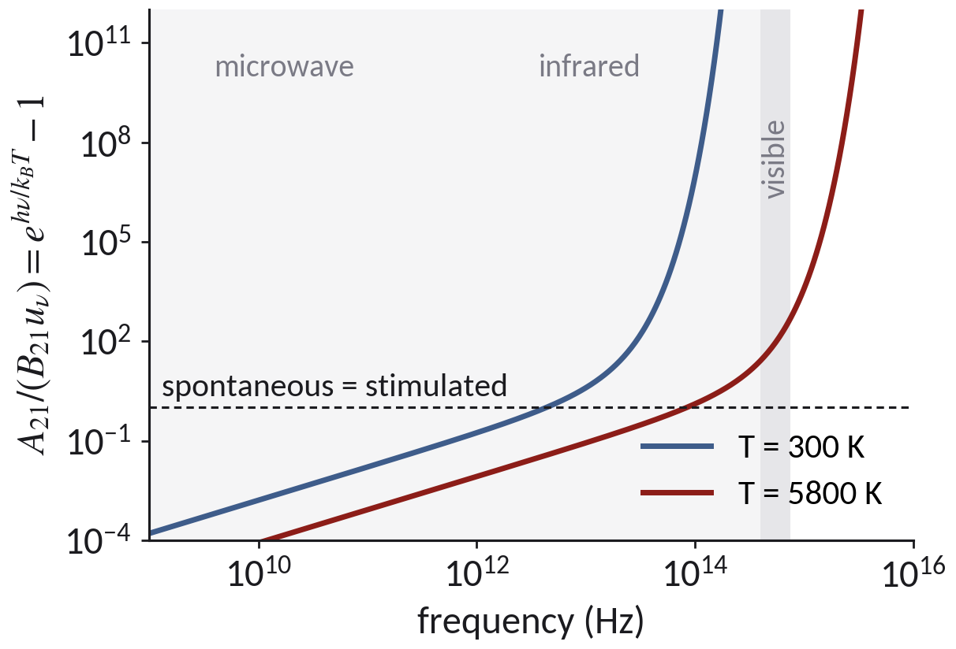
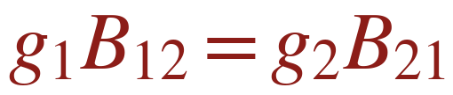
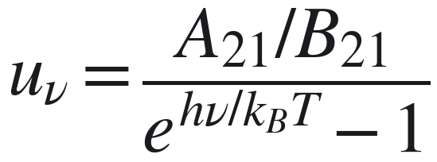
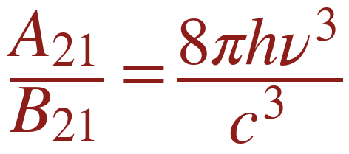
What the balance requires
As T → ∞, u_{ν} must grow without limit at every ν. The denominator must vanish in that limit:
Then the field is already of Planck's form:
The Rayleigh–Jeans limit at hν ≪ k_{B}T fixes the ratio:
Nothing about the spectrum was assumed beyond the classical limit.
Modern Physics · Lecture 1, part II · Wien, Planck, Einstein
14
Notes:
This is a consistency result: the structure of the three processes plus Boltzmann and the classical limit fix A/B. The form of Planck's law comes out, it is not put in.

Slide 15
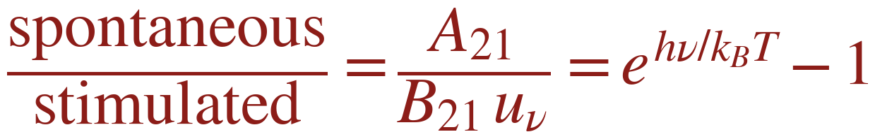
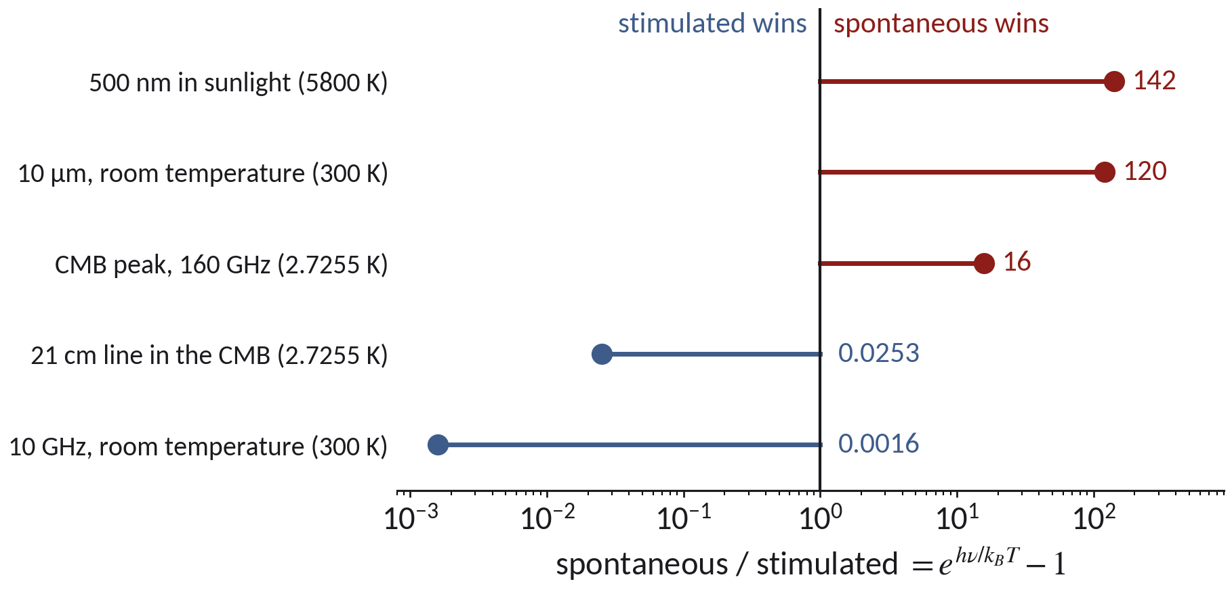
Spontaneous or stimulated?
At 500 nm in sunlight (5800 K) the ratio is about 142: stimulated emission is a correction below 1%.
The two rates are equal at hν = k_{B}T ln 2, that is 84 THz or 3.6 μm at 5800 K.
At microwave frequencies stimulated emission wins. This is why the maser came before the laser.
A laser needs a field far above the thermal one at its own frequency.
Modern Physics · Lecture 1, part II · Wien, Planck, Einstein
15
Notes:
Also: Einstein shows that every elementary process carries momentum hν/c, directional for spontaneous emission. This is the link to Compton scattering (Lecture 3). End of the 60–95 min block.

Slide 16
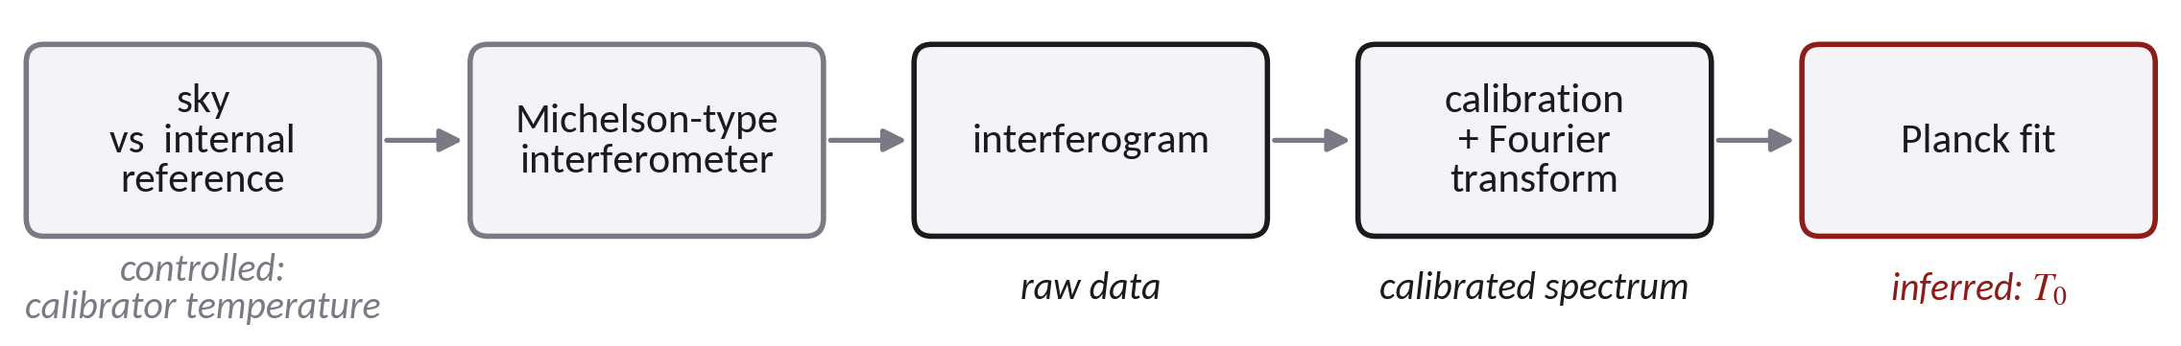
COBE/FIRAS: from the apparatus to the parameter
Controlled quantity: the temperature of the on-board calibrator, set to known values and measured.
Inferred parameter: T₀, and the residuals from a Planck curve.
Systematics by effect: they shift (thermometer scale), reduce contrast (reference emissivity below 1), add a false signal (residual galactic and interplanetary emission), broaden the response (finite spectral resolution).
Modern Physics · Lecture 1, part II · Wien, Planck, Einstein
16
Notes:
95–110 min block, slide 1 of 3. The list of systematics is typical; check it against Fixsen et al. 1996 before using it in class. Errors in the upper panel of the data plot are multiplied by 400.

Slide 17
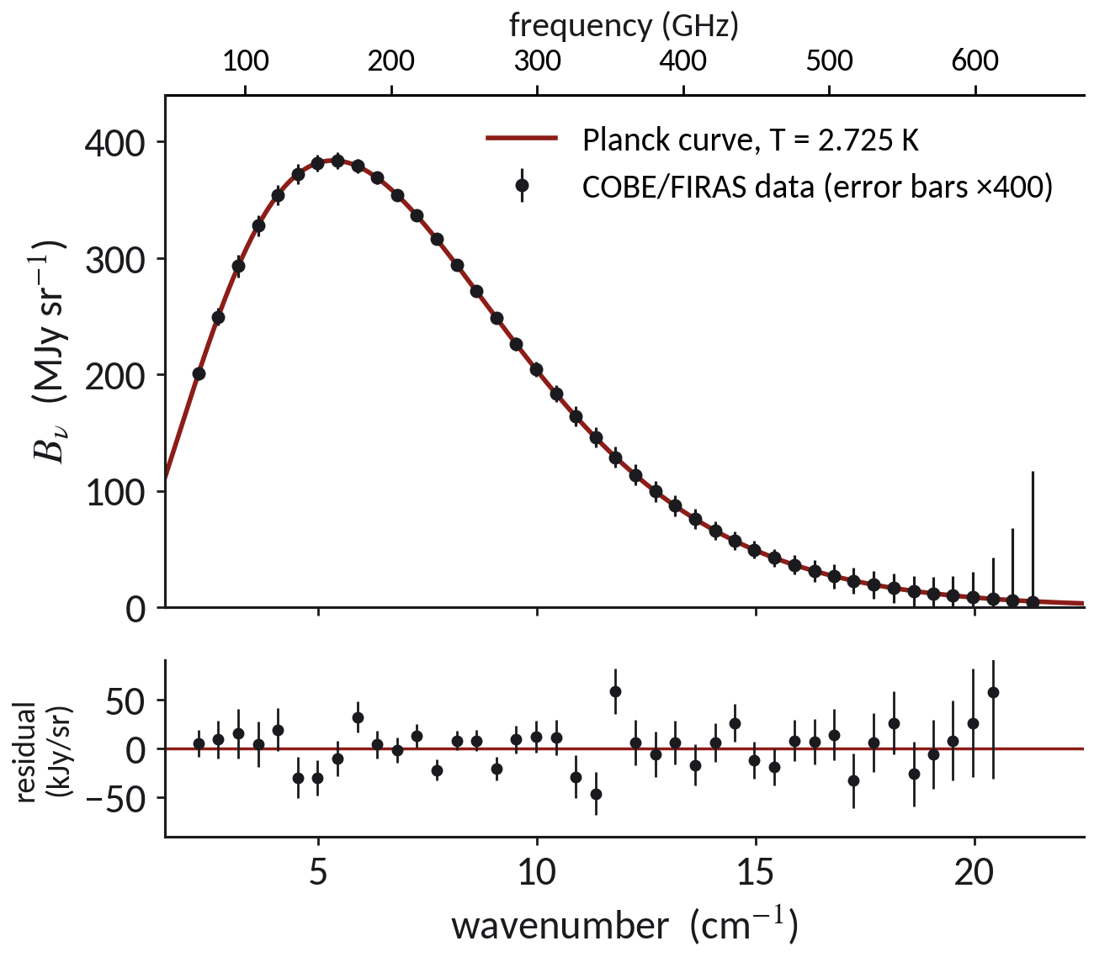
One Planck curve through the whole spectrum
COBE/FIRAS (1989–1990) measured the cosmic microwave background between 68 and 640 GHz.
A single Planck curve, with one parameter T₀ = 2.725 K, goes through all 43 points.
The residuals scatter by about 50 parts per million of the peak.
So matter and radiation were in thermal equilibrium in the early universe. Mather and Smoot shared the 2006 Nobel Prize for COBE.
Data: COBE/FIRAS, Fixsen et al., ApJ 473, 576 (1996), from NASA LAMBDA. Error bars in the upper panel are multiplied by 400.
Modern Physics · Lecture 1, part II · Wien, Planck, Einstein
17
Notes:
Real data. The bottom panel shows the true residuals in kJy/sr.

Slide 18
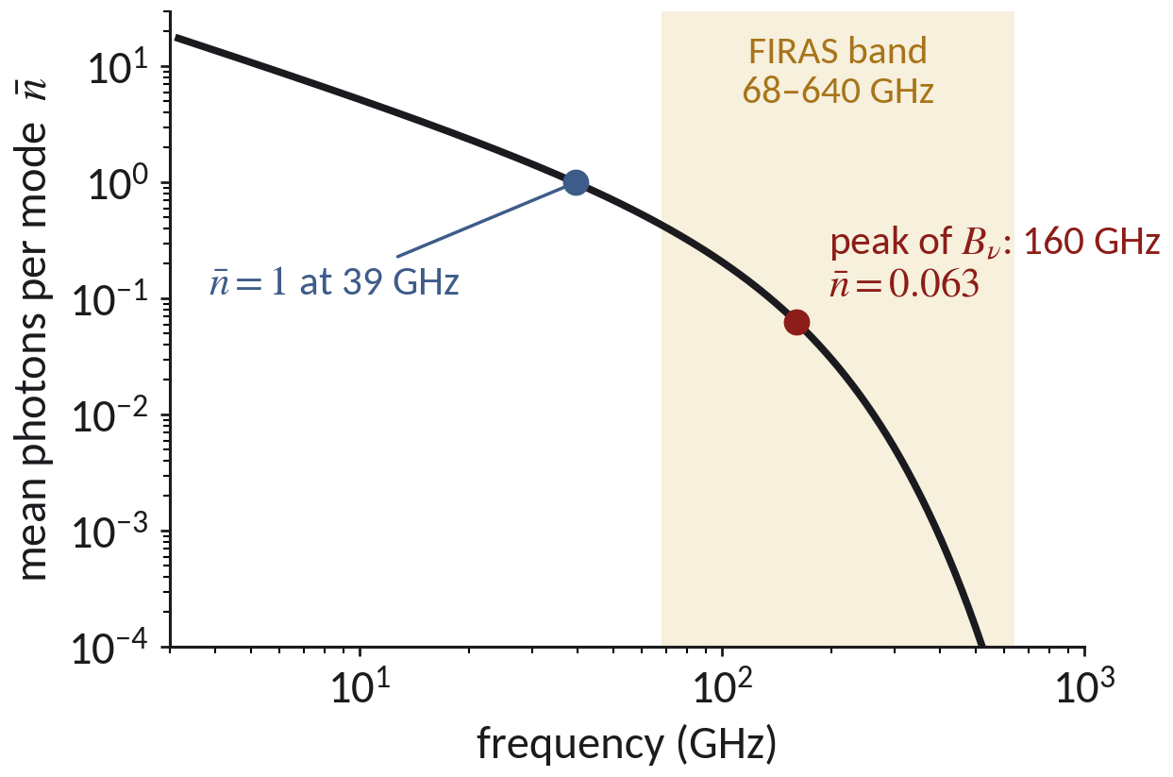
The numbers to remember
T₀ = 2.7255 K (Fixsen 2009: 2.72548 ± 0.00057 K).
B_{ν} peaks at x = hν/k_{B}T = 2.8214: 160 GHz, i.e. 58.8 GHz per kelvin. B_{λ} peaks at 1.06 mm. The two peaks do not coincide.
Residuals from a Planck curve: under 50 parts per million of the peak.
At the peak of B_{ν} the mean occupation of a mode is n̄ = 0.063. The occupation reaches 1 only at 39 GHz.
Even at the peak the field is far from the classical limit n̄ ≫ 1: this is quantum radiation.
Modern Physics · Lecture 1, part II · Wien, Planck, Einstein
18
Notes:
Data: Fixsen et al., ApJ 473, 576 (1996), and Fixsen, ApJ 707, 916 (2009). Mather and Smoot shared the 2006 Nobel Prize for COBE.

Slide 19
Three roads, one constant
 | Starting point | Regime | What it gives
Einstein 1905 | entropy of Wien radiation | hν ≫ k_{B}T only | N = E/hν independent quanta
Planck 1900 | interpolation of s″(U), then E_{n} = nhν | all frequencies | U = hν/(e^{hν/kBT} − 1)
Einstein 1917 | balance of three processes | all frequencies, plus the classical limit | A₂₁/B₂₁ = 8πhν³/c³, momentum hν/c
The h of the spectrum and the h of the photoelectric effect (Lecture 2) are two independent measurements. The 1917 argument is not a third: it assumes E₂ − E₁ = hν.
The spectrum alone does not decide what is quantized: the oscillators, the field, or only the exchange.
Modern Physics · Lecture 1, part II · Wien, Planck, Einstein
19
Notes:
110–120 min block. Ask which of the three are independent measurements of h.

Slide 20
Questions before you leave
1. Why does the entropy argument give N = E/hν only for hν ≫ k_{B}T?
2. Which two measured limits does Planck's interpolation reproduce, and why is it still only a conjecture?
3. Why must g₁B₁₂ = g₂B₂₁, and what is assumed about the spectrum to get A₂₁/B₂₁?
4. At 5800 K, at which wavelength are spontaneous and stimulated emission equal?
5. Why is n̄ ≈ 0.06 at the peak of the cosmic background, and what does that say about the field?
Next: the photoelectric effect. If a quantum carries hν, what should the electrons do?
Modern Physics · Lecture 1, part II · Wien, Planck, Einstein
20
Notes:
Answers: 3.58 μm for question 4 (hν = k_BT ln 2). Question 5: n̄ = 1/(e^2.82 − 1).

