Slide 1

iCRIOS
Invernizzi Center for Research on Innovation, Organization and Strategy
Patenting in
Adriatic region
data and coverage in PATSTAT
Trieste 9/5/2016
Gianluca Tarasconi, iCrios DBA
rawpatentdata.blogspot.com
Notes:
1

Slide 2
In brief
The goal of this presentation is to analyze EPO PATSTAT as data source for Adriatic area countries and its pro and cons.
It will be also shown what source within patstat could be more reliable if national or international patent office

Slide 3
Why PATSTAT
Obviously, where available the best data sources are national patent offices but some issues arise when trying to use the files to get one integrated DB (different formats, information missing, data unavailable for some authorities) and most of all the BI effort is very heavy.
EPO Patstat offers an integrated source of data, a lot of plug and play extensions (ie nutsificatons, standard names…); most of all data can be compared to other patent offices or get some other data (ie triadics/PCT/characteristic of cited / citing)
WIPO IP Statistics Data Center (on-line service enabling access to WIPO's statistical data) ,and WIPO Statistical Country Profiles for around 190 countries have a wider coverage but dont allow to build our own indicators.
On the other hand data available have different reliability and coverage: limitations apply…

Slide 4
Data from national patent offices (4 examples):
Croatia: http://www.dziv.hr/en/e-services/on-line-database-search/patents/
good search engine – no raw data
Macedonia: http://www.ippo.gov.mk/Search/FederatedPatentRegister.aspx
  Limitation to ep/pct ; modest search – nor raw data

Slide 5
Data from national patent offices (4 examples):
Italy: http://brevettidb.uibm.gov.it/ good text search engine – no raw data – no search by inv / appl
Serbia: http://89.216.38.53/rs-pubserver/search.jsp?lg=en
modest search - no raw data
WIPO pages links:
http://www.wipo.int/ipstats/en/resources/office_stats_reports.html

Slide 6
Data from national patent offices to Patstat:
National offices convey to EPO local applications
Timeframe, modalities and information shared can differ from office to office

Slide 7
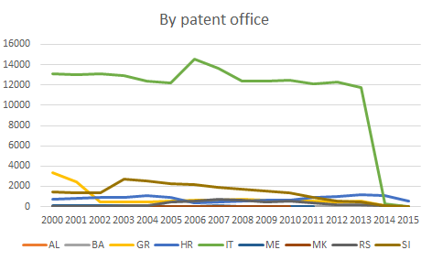
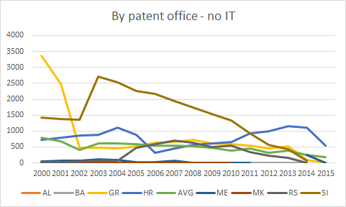
Coverage check: a sheer publication count (I)
Select a.APPLN_AUTH, a.FILING_YEAR, Count(a.APPLN_ID) From applications a Group By a.APPLN_AUTH, a.FILING_YEAR

Slide 8

Coverage check: a sheer application count (II)
 | 2000 | 2001 | 2002 | 2003 | 2004 | 2005 | 2006 | 2007 | 2008 | 2009 | 2010 | 2011 | 2012 | 2013 | 2014 | 2015
AL |  |  |  |  |  |  |  |  |  |  | 1 |  | 1 | 1
BA | 4 | 8 | 4 | 7 | 2 | 7 | 7 | 11 | 8 | 7 | 7 | 5 | 8 | 6 | 5
GR | 3363 | 2479 | 477 | 480 | 460 | 514 | 624 | 652 | 713 | 620 | 587 | 548 | 460 | 515 | 88 | 1
HR | 720 | 782 | 867 | 882 | 1105 | 882 | 328 | 449 | 576 | 607 | 663 | 933 | 1001 | 1162 | 1116 | 534
IT | 13069 | 13037 | 13095 | 12914 | 12353 | 12233 | 14582 | 13614 | 12397 | 12364 | 12479 | 12155 | 12283 | 11782 | 239 | 7
ME | 55 | 67 | 79 | 105 | 87 | 18 | 31 | 64 | 6 | 2 | 1 | 4
MK | 3 | 3 | 6 | 2 | 3 | 1 | 2 | 4 | 1 | 2 | 2 |  | 2 |  | 3
RS | 19 | 28 | 48 | 67 | 77 | 466 | 581 | 705 | 645 | 497 | 543 | 334 | 224 | 152 | 61
SI | 1418 | 1382 | 1346 | 2710 | 2527 | 2257 | 2178 | 1946 | 1736 | 1526 | 1328 | 922 | 565 | 436 | 85 | 5
Greatly differ from official data
(caveat: data transmission lag to EPO can differ from office to office so comparisons amons very recent data can lead to misguiding results)
HR data source: http://www.dziv.hr/files/File/go-izvjesca/godisnje_izvjesce_2013.pdf

Slide 9
Percentage of granted patents and PCT (II)
Granted patents = application has passed examination and succesfully reached grant phase;
PCT = applied at local office, for PCT (Patent Cooperation Treaty - wipo) route (see http://www.wipo.int/pct/en/)
(SQL CODE IN APPENDIX)

Slide 10
Percentage of granted patents and PCT (II)

Slide 11
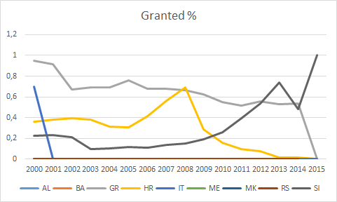
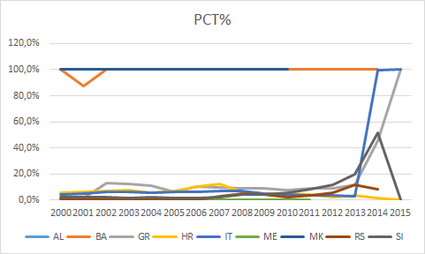
% of granted and PCT patents (III)
Grants data: some countries do not update data after application (IT, RS,BA, MK…) some have unrealistic % (SI)
PCT %: 100% means only PCT data in patstat; note last 2 years data: means transmission lag between epo and national offices

Slide 12
What then?
National data not reliable
Usage of PCT data
+ reliable, homogenuous
- bias toward high expected value
- address quality bad (→ enrichment with OECD regpat http://www.oecd.org/sti/inno/oecdpatentdatabases.htm

Slide 13
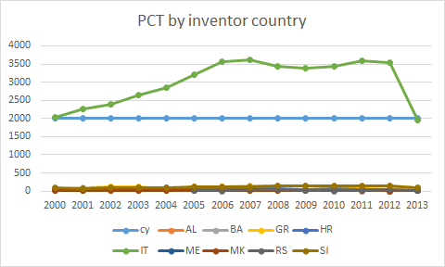
Using PCT data
Counting PCT patents by inventors country

Slide 14
TOP 20 patenting regions
By NUTS2 – Italy excluded – priority year > 2000

Slide 15
Italian Adriatic regions at their best
Ctry_code | region | Earliest filing year | napp
IT | EMILIA-ROMAGNA | 2007 | 626
IT | VENETO | 2009 | 515
IT | FRIULI-VENEZIA GIULIA | 2012 | 220
IT | MARCHE | 2006 | 127
IT | PUGLIA | 2007 | 87
IT | ABRUZZO | 2008 | 69
IT | MOLISE | 2009 | 8
Best y2k: LOMBARDIA 2006 - 1211

Slide 16
Copatenting
Copatenting between 2 countries with 3 or more patents in one year

Slide 17
Most patented technologies
By ipc4, country, after y2k (sql code in appendix)
cpc4 | Ctry_code | Count appln id | Description
A61K | IT | 4489 | PREPARATIONS FOR MEDICAL, DENTAL, OR TOILET PURPOSES
A61K | SI | 310 | PREPARATIONS FOR MEDICAL, DENTAL, OR TOILET PURPOSES
A61K | GR | 228 | PREPARATIONS FOR MEDICAL, DENTAL, OR TOILET PURPOSES
A61K | HR | 183 | PREPARATIONS FOR MEDICAL, DENTAL, OR TOILET PURPOSES
G06F | RS | 22 | DIGITAL COMPUTERS IN WHICH AT LEAST PART OF THE COMPUTATION IS EFFECTED ELECTRICALLY; ARRANGEMENTS FOR HANDLING DIGITAL DATA
F03D | BA | 8 | WIND MOTORS
A61F | MK | 4 | PATENCY TO, OR PREVENTING COLLAPSING OF, TUBULAR STRUCTURES OF THE BODY, E.G. STENTS; ORTHOPAEDIC, NURSING OR CONTRACEPTIVE DEVICES; FOMENTATION; TREATMENT OR PROTECTION OF EYES OR EARS
A61C | ME | 3 | DENTISTRY; APPARATUS OR METHODS FOR ORAL OR DENTAL HYGIENE
A63C | AL | 3 | SKATES; SKIS; ROLLER SKATES; DESIGN OR LAYOUT OF COURTS, RINKS OR THE LIKE

Slide 18
Knowledge spillovers
Citations
between
countries
citing | cited | Count of citation
SI | IT | 75
GR | IT | 70
IT | SI | 51
IT | GR | 45
HR | IT | 43
IT | HR | 23
GR | SI | 15
SI | HR | 8
HR | SI | 7
RS | IT | 6
BA | IT | 3
GR | HR | 3

Slide 19
Conclusions
National data are not reliable in patstat
PCT data have a bias towards tech and applicants with international propension
Comparison can be done by groups (small vs small / big vs big)

Slide 20
Appendix 1: SQL code for PATSTAT (I)
create table applications
Select
APPLN_ID,
APPLN_AUTH,
APPLN_NR,
APPLN_KIND,
year(appln_filing_date) As FILING_YEAR,
APPLN_AUTH As REFAPPLN_AUTH,
"N" As GRANTED,
IF(appln_kind = "W", "Y", "N") as PCT
From
patstat.tls201_appln T01
where
appln_auth in ('AL','BA','GR','HR','IT','ME','MK','RS','SI‘) and appln_kind <> "D2"
and year(appln_filing_date) <>9999;
-- Removes unpublished
delete a.*
From
applications a Left Join
patstat.tls211_pat_publn b On a.APPLN_ID = b.APPLN_ID
where b.appln_id is null;

Slide 21
Appendix 1: SQL code for PATSTAT (II)
-- sets grant flag
update
applications a Inner Join
patstat.tls211_pat_publn b On a.APPLN_ID = b.APPLN_ID
set
a.GRANTED = "Y"
Where
b.PUBLN_FIRST_GRANT = 1;
-- PCT / TRIADIC / GRANTED CALC
Select a.FILING_YEAR, a.REFAPPLN_AUTH, Sum(If(a.GRANTED = 'Y', 1, 0)) / Count(a.APPLN_ID) As gr,
Sum(If(a.PCT = 'Y', 1, 0)) / Count(a.APPLN_ID) As pct
From applications a Group By a.FILING_YEAR, a.REFAPPLN_AUTH

Slide 22
Appendix 1: SQL code for PATSTAT (III)

Slide 23
Appendix 1: SQL code for PATSTAT (IV)
-- ipc4 by country year
use test2;
drop table if exists t1;
drop table if exists t6;
create table t6 as
select * from otherdbs.pct_inv_reg where CTRY_CODE in ('AL','BA','GR','HR','IT','ME','MK','RS','SI');
create table t1 as
select * from patstat.tls201_appln
where APPLN_KIND = 'W';
alter table t6 add index i1(appln_id);
alter table t1 add index i1(appln_id);
--count by cy ipc4
create table cpc4_by_cy_year
Select
Left(t24.ipc_class_symbol, 4) As ipc4, test2.t6.Ctry_code,
Count(Distinct t24.appln_id) As Count_appln_id
From
test2.t1 Inner Join
patstat.tls209_appln_ipc t24
On t24.appln_id = test2.t1.APPLN_ID Inner Join
test2.t6
On test2.t1.APPLN_ID = test2.t6.Appln_id
Where
test2.t1.EARLIEST_FILING_YEAR > 1999
Group By
Left(t24.ipc_class_symbol, 4), test2.t6.Ctry_code, test2.t1.EARLIEST_FILING_YEAR;

